Slide 1
Introduction of UI & UX

Slide 2
What is UX Design?
UX means User experience
User experience (UX) refers to any interaction a user has with a product or service.
UX design considers each and every element that shapes this experience, how it makes the user feel, and how easy it is for the user to accomplish their desired tasks.
This could be anything from how a physical product feels in your hand, to how straightforward the checkout process is when buying something online.
The goal of UX design is to create easy, efficient, relevant and all-round pleasant experiences for the user.

Slide 3
The Difference Between UX And UI Design
It’s important to recognize that, despite often being used interchangeably, UX and UI are two different things.
UX is focused on the user’s journey to solve a problem; UI is focused on how a product’s surfaces look and function.
User interface design is not the same as UX.
UI refers to the actual interface of a product; the visual design of the screens a user navigates through when using a mobile app, or the buttons they click when browsing a website.
UI design is concerned with all the visual and interactive elements of a product interface, covering everything from typography and color palettes to animations and navigational touch points (such as buttons and scrollbars).

Slide 4
The Difference Between UX And UI Design
UX and UI go hand-in-hand, and the design of the product interface has a huge impact on the overall user experience. Learn more about the difference between UX and UI design in this guide.
UX design is everywhere: the layout of a supermarket, the ergonomics of a vehicle, the usability of a mobile app.
While the term “user experience” was first coined by Don Norman in the 90s, the concept of UX has been around for much longer.

Slide 5
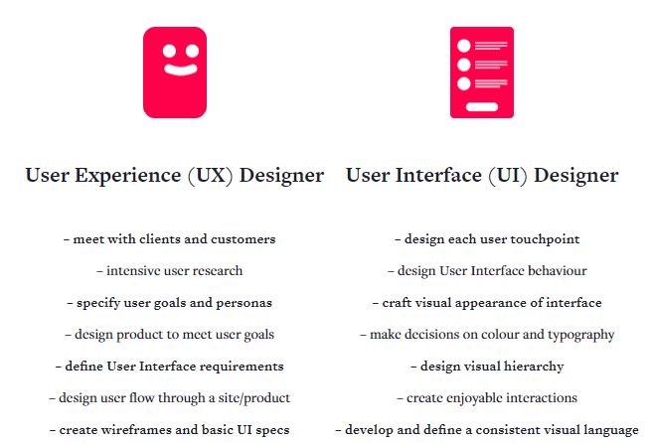
The Difference Between UX And UI Design

Slide 6
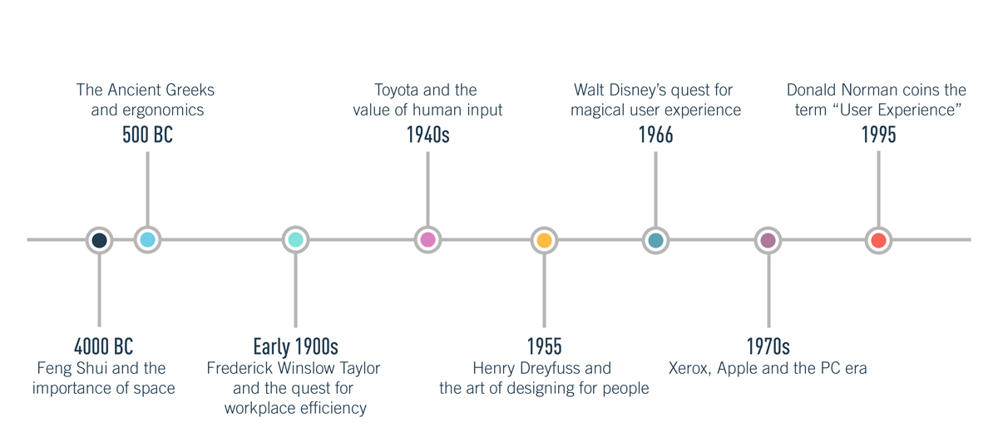
The History Of UX Design

Slide 7
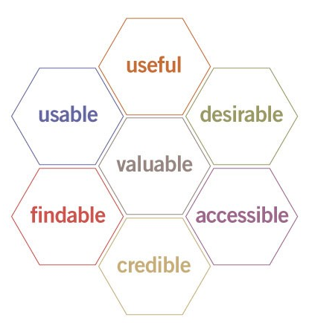
What is a good user experience?
When a UX or UI designer begins a project, their overall aim is to create a product which will allow the user to meet their goals as efficiently and enjoyably as possible.

Slide 8
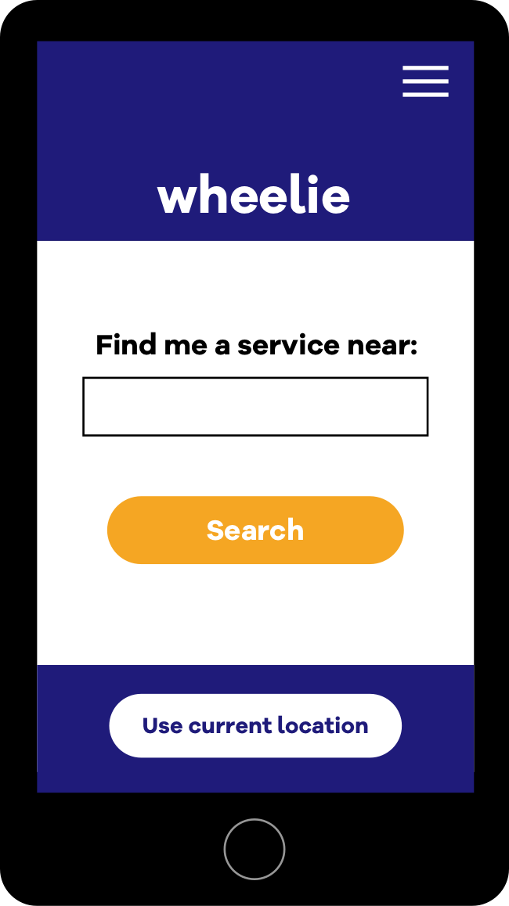
What is a good user experience?
Let’s try to understand these by way of an example.
Suppose we are building an app that promises to find you somewhere local to service your bicycle, and then allows you to book an appointment.
The qualities of a good user experience of this app might be something like this:

Slide 9
What is a good user experience?
Useful: allows the user to successfully find a convenient service point and book an appointment without an hour of Googling and phone calls.
Usable: the app itself is intuitive and its functions work properly. When the user taps “find service points near me”, the results are accurate and come back quickly.
Findable: the User Interface design allows users to find the buttons and menus they need. When the user needs to cancel an appointment, they don’t have to go through eight screens or send a fax to the shop.

Slide 10
What is a good user experience?
Desirable: the app looks and feels cool, which makes the user (and their friends) want to use it. The aesthetic choices resonate with the target market and personas identified during user research (think hipster fonts, not Times New Roman)
Accessible: the service is designed with disability needs in mind. The app uses high-contrast colours and legible text sizes in the app, and indicates which service points have disabled access issues.

Slide 11
What is a good user experience?
Credible: generates trust between the user, the service, and its partners. The app has a customer service section and a “Help!” button. The checkout screens look professional and don’t ask for more information than necessary.
Valuable: offers a valuable enhancement for the user, and a source of monetary or other value for the company or service provider.

Slide 12
What Does A UX Designer Do?
UX designers seek to make everyday products, services and technology as user-friendly and accessible as possible.
They employ design thinking to reconcile the user’s desires with technical feasibility and business viability.
The diagram in next slide shows the Design Thinking Process.
The Design Thinking Process can be broken down into four different stages: inspiration, conceptualization, iteration and exposition.
During the inspiration stage, the UX designer seeks to understand and observe. To do this, they conduct extensive research and competitor analysis in order to fully grasp the problem or challenge they are setting out to solve. This involves interviewing those who are, or will be, directly engaged with the product.

Slide 13
What Does A UX Designer Do?
The designer then uses this feedback to identify the user’s goals, emotions, pain-points and behaviors. All of this information helps to form user personas. The next step is to consider what these personas are trying to accomplish when using a particular product, and the journey they will take to do so. The designer considers information architecture and uses various techniques, such as card sorting, to map out user flows.
Once the user flows have been determined, the designer knows what steps the user needs to take to complete their desired tasks. They will visually brainstorm solutions for each of these steps, creating wireframes and prototypes of what the final product might look like.

Slide 14
What Does A UX Designer Do?
With prototypes to hand, the UX designer will then conduct usability tests to see how users interact with the product. This shows whether or not the user is able to complete their desired tasks, or if changes need to be made.
UX designers not only come up with solutions to user problems; they also need to present their ideas and designs to key stakeholders as part of their day-to-day work.
This is just a broad overview of the UX design process. In reality, tasks will vary depending on both the size and the specific needs of the company. Larger companies might employ a team of designers, with each focusing on a specific aspect of the process such as research or visual design. In smaller companies and startups, it’s not unusual for the UX designer to wear many different hats and take on the whole spectrum of tasks.

Slide 15
What Does A UX Designer Do?
No matter what product or service they are designing, or what stage of the process they are at, UX designers will ask themselves the following questions:
Is the product usable? Is it logical, self-explanatory and easy to use?
Does the product or service solve an existing user problem?
Is it accessible for different categories of users? You can read more about accessibility in design below.
Is the product or service desirable? Does it create a positive experience which the user would be happy to repeat?

Slide 16
What Kinds Of Projects Do UX Designers Work On?
As the tech industry grows, the field of UX design is becoming increasingly varied. UX designers can find themselves working on a wide range of projects within various contexts. Here are just some applications for UX design.
Website, App And Software Design
Voice Design
Voice user interfaces are revolutionizing the way we interact with technology. In the U.S., around 50% of adults use voice search on a daily basis, and ComScore estimates that, in the early 2020s, 50% of all searches will be voice-based. UX designers have a huge role to play in the rise of voice, as products like Amazon Alexa can only be successful if they are user-friendly and accessible for the masses. Designing for voice requires a slightly different approach to that of websites and apps
Virtual Reality (VR) and Augmented Reality (AR)
Service Design

Slide 17
The Value of UX Design
Universal Design (UD)
Universal design follows seven key principles:
Equitable use: The design is useful and marketable to people with diverse abilities.
Flexibility in use: The design accommodates a wide range of individual preferences and abilities.
Simple and intuitive use: Use of the design is easy to understand, regardless of the user’s experience, knowledge, language skills, or current concentration level.
Perceptible information: The design communicates necessary information effectively to the user, regardless of ambient conditions or the user’s sensory abilities.
Tolerance for error: The design minimizes hazards and the adverse consequences of accidental or unintended actions.
Low physical effort: The design can be used efficiently and comfortably and with a minimum of fatigue.
Size and space for approach and use: Appropriate size and space is provided for approach, reach, manipulation, and use regardless of user’s body size, posture, or mobility.
Good Design Is Good Business

Slide 18
How To Become A UX Designer
There is no standard background or path that leads to a career in UX. However, the best UX designers typically share certain qualities and attributes, including:
An ability to think both creatively and analytically
A strong gift for empathy and a user-first mindset
An interest in technology and how humans interact with it
Strong problem-solving skills
Strong communication skills and ability to collaborate

Slide 19
What Are The Most Important UX Design Skills?
Some requirements you will often see in UX designer job descriptions include:
Proficiency in creating user stories, personas, sitemaps, wireframes, prototypes and storyboards
Ability to plan and conduct user testing, surveys, and formal evaluations
Ability to iterate your work based on user testing data and qualitative feedback
Understanding of interaction design principles and information architecture
Ability to translate goals, objectives, and data into digital experiences
Understanding of business metrics, and how your designs contribute to performance
Strong communication and presentation skills; an ability to articulate and discuss your design decisions with clients and stakeholders
Flexibility and adaptability

Slide 20
Core UX & UI terms
Here’s our list of 10 core terms.
For a longer list, checkout https://uxmastery.com/resources/glossary/
User-centered design: a design process where the primary point of reference are user needs (rather than, say, programmer or business needs).
User research: Information-gathering techniques used to gain an understanding of user behaviors and requirements. Could include user interviews, which are formal meetings or informal conversations held with a user or group of users, to help the UX designer gain an understanding of their needs and goals.

Slide 21
Core UX & UI terms
User journey: A description of the steps the user follows to reach their goal when interacting with the product.
Usability: How easy it is to learn to interact with the product.
Persona: a profile of one of your user groups (e.g. Pat the project manager, Ann the accountant, Rob the receptionist) that identifies their character and expected goals when using your product.
Ideation sketches: small, low-detail thumbnails of user touchpoints like websites, apps, and packaging.
Wireframe: a rough outline of a webpage or app design. The purpose of a wireframe is to plan layout and visual hierarchy without the distractions of images, color, or typography.

Slide 22
Core UX & UI terms
Mockup: A picture of the final website, app, or product as it would look – but without any interactions included (this would be a prototype).
Prototype: A prototype is a simulation of a final product made for testing. In particular, it tests whether the user’s journey through the app or website is as intended, and whether it allows the user to reach their goal in a satisfactory way.
Deliverable: A product you will give to the client. This could be an interim product like a wireframe or a mockup, or it could be the finished item, like a final style guide or full set of app screen designs.

Slide 23
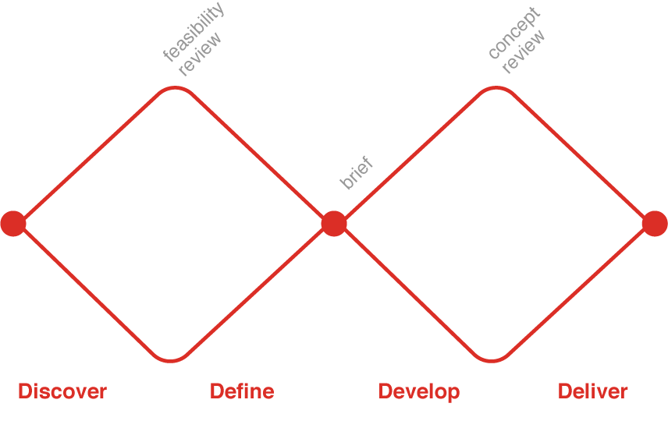
Double Diamond
The 'double diamond' design process model pioneered by the British Design Council, the steps involve these phases of a project; Understand, Define, Diverge, Decide, Prototype and Validate.

Slide 24
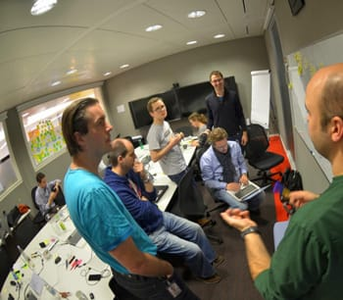
Validating the problem
Internal interviews with stakeholders

Slide 25
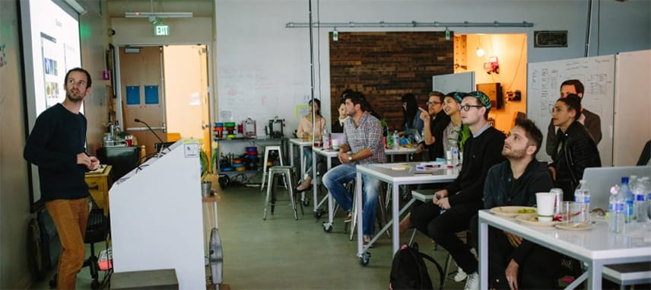
Validating the problem
Lightning talks

Slide 26
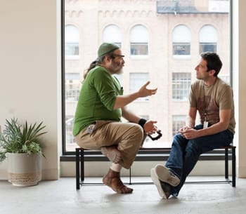
Validating the problem
User interviews

Slide 27

Validating the problem
Ethnographic field research
Seeing users in their natural environment is a great way to understand how they solve their own challenges.
This is where you observe the user in the field, in context while doing something like how they do their shopping, how they travel to work, how they send SMS messages etc..

Slide 28
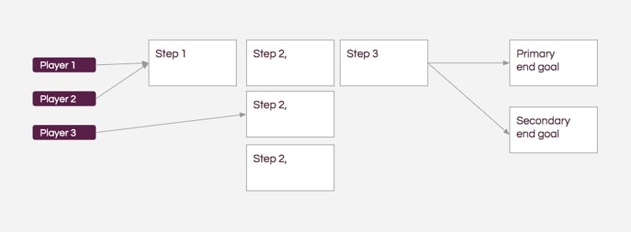
Project Map

Slide 29
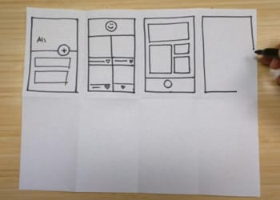
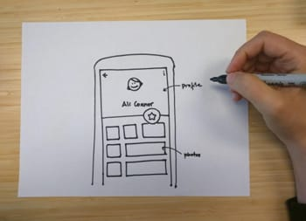
Wireframing and storyboarding

Slide 30
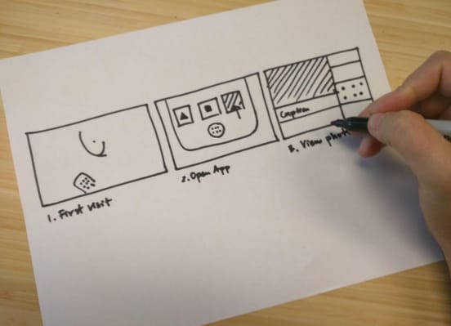
Storyboard the idea

Slide 31
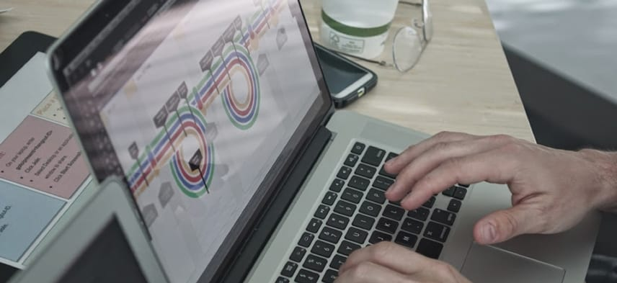
Creating a prototype

Slide 32

Usability-test your designs
Questions to ask:
When testing your design, ask the user to perform tasks in your app and get them to speak aloud and verbalize what they're doing and why.

Slide 33
Usability-test your designs
What you need to find out is:
What do they like about the prototype?
What do they dislike about the prototype?
What are the pain points?
Why did a flow work
Why did a flow not work
What would they like to improve?
Does the overall design/flow meet their needs?

Slide 34
Revisit designs and another round of testing
You have a working prototype with feedback.
Now it’s time to revise your designs, and analyze what worked and what didn’t.
Don't be afraid to create a completely new wireframe storyboard and make a new prototype.
Starting over can create a better flow than trying to move things on your earlier prototype.
Try not to be too precious of it because it is just a prototype.
Once you are happy with your designs you can test it again and refine it some more.

Slide 35
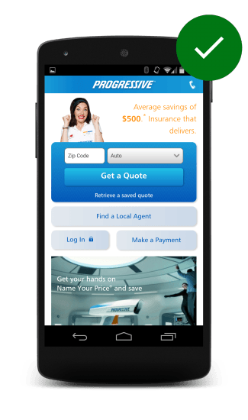
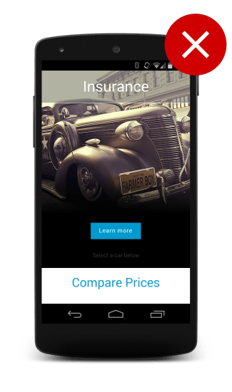
Do & Don’t for Mobile Site
https://developers.google.com/web/fundamentals/design-and-ux/principles

Slide 36
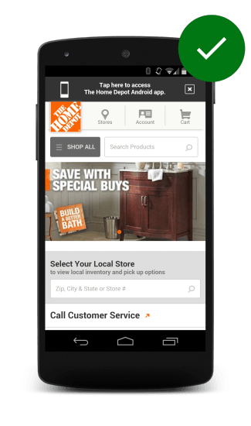
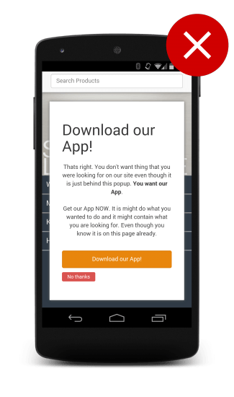

Slide 37
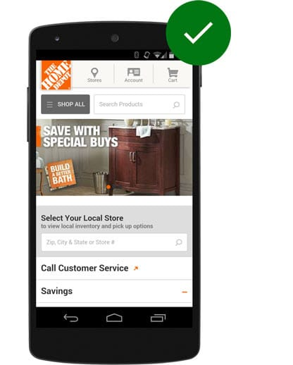
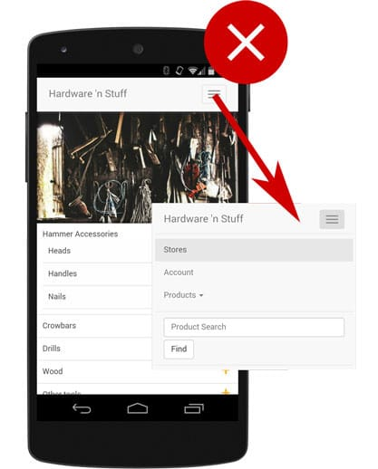

Slide 38
Core UX & UI tools
A nice notebook with squared or dotted paper will allow you to sketch ideas, thumbnails, and brainstorm user personas.
Wireframing tools: there a lot of packages out there. We suggest starting out by experimenting with inexpensive packages like Balsamiq Mockups, Framebox, and Sketch. If you want to explore more, http://www.creativebloq.com/wireframes/top-wireframing-tools-11121302
Graphic design tools: get familiar with Photoshop and Illustrator – you can try them out with a free trial of Adobe Creative Cloud. Sketch is great for putting together high-fidelity mockups and creating user interface assets like icons and illustrations. You could also experiment with Figma, which is a bit like an in-browser version of Sketch.

Slide 39
Core UX & UI tools
Collaboration & prototyping tools: try out Adobe XD, Origami Engine, Framer JS, Invision, and Marvel.

Slide 40
Learn Adobe XD

